Slide 1
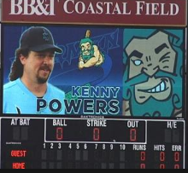


Picking Pitchers
Predicting Starting Pitcher Success at Coors Field based on Pitching Profile

Slide 2


Why Coors?
Since its inception in 1995, Coors has been feared by pitchers and praised by hitters
3rd most run per game by stadium since 2010
Typically O/U totals for MLB hover in the 6-8 range, Coors consistently in the 11 plus range with O/U maxing at 14 ½ this year
Currently run totals this season are averaging 12.83 runs per game
Notes:
May require more than one slide

Slide 3
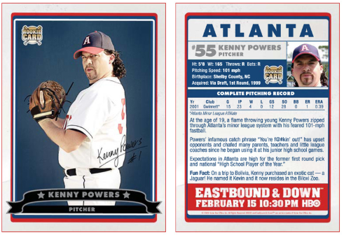
Profiling Pitchers Traditional
Obtaining Data to profile pitchers?
Traditional
Scouts would use eye test and pitch charts
Radar Guns
Information on the back of a baseball card
ERA
Hits
Innings Pitched
Strikes Outs
Walks
Notes:
May require more than one slide

Slide 4
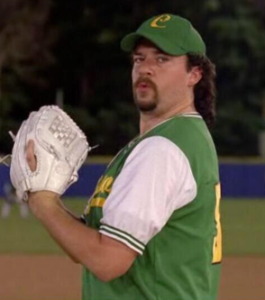
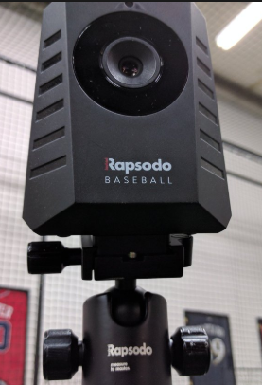

Profiling Pitchers Modern
How do we create a pitcher Profile?
Modern
PITCHf/x debuts in 2006
Mounted Cameras installed in every MLB Stadium
Track a great number of metrics including
Velocity
Spin Rate
Vertical/Horizontal Movement
Pitch Classifier
Ball/Strike information
Exit Velocity
Notes:
May require more than one slide

Slide 5
Extracting Data
Traditional Baseball Data
Utilize www.baseball-reference.com
Pull every home game played at Coors
Starting Pitchers
Runs
Ks
Earned Runs
Hits
2B,3B, and Homeruns
Innings
BBs
PITCHf/x Data
Utilize http://www.brooksbaseball.net/
Pull every pitcher with at least 5 starts at Coors Filed
Pitch Type
Velocity
Horizontal/Vertical Movement
Pitch %
Ground Ball, Fly Ball, Whiff %
Swings, Fouls, Balls in Play
Strikes/Balls
Notes:
May require more than one slide

Slide 6
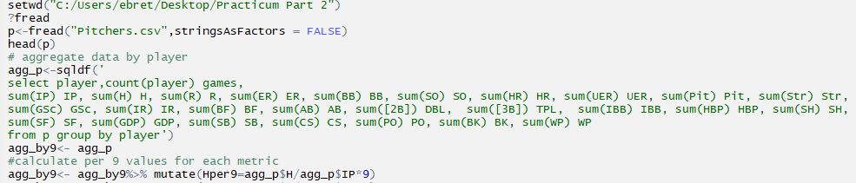
Baseball Reference Pull
Initial Code to grab data from www.baseball-reference.com
Each metric turned into by a per 9 rate for
Notes:
May require more than one slide

Slide 7
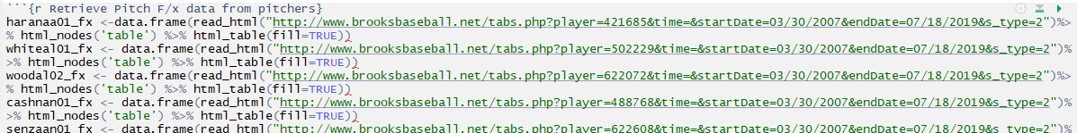
Scrape PITCHf/x Data Pitch Descriptions
I had issues incorporating a for loop due to the changing variable being in the middle of my URL string as opposed to the end.
Each line represents a pitcher and call to the http://www.brooksbaseball.net/ website
Notes:
May require more than one slide

Slide 8
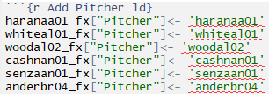
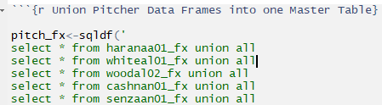
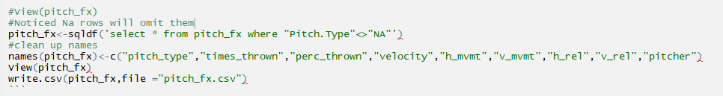
Clean PITCHf/x Data Pitch Descriptions
Since all these calls created separate data frames by pitcher, I needed to add a column for the pitcher and union them which is shown in the following scripts.
Remove NAs and clean up names then store
Notes:
May require more than one slide

Slide 9
Scrape PITCHf/x Data Pitch Outcomes
I had issues incorporating a for loop due to the changing variable being in the middle of my URL string as opposed to the end.
Each line represents a pitcher and call to the http://www.brooksbaseball.net/ website
Notes:
May require more than one slide

Slide 10
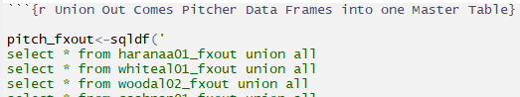
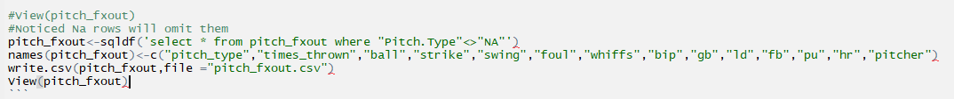
Clean PITCHf/x Data Pitch Outcomes
Since all these calls created separate data frames by pitcher, I needed to add a column for the pitcher and union them which is shown in the following scripts.
Remove NAs and clean up names then store
Notes:
May require more than one slide

Slide 11
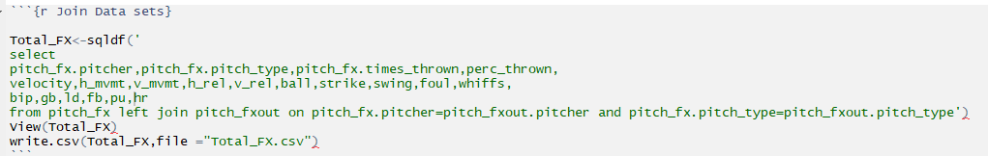
Wrangling PITCHf/x
Join PITCHf/x Data Sets
Notes:
May require more than one slide

Slide 12
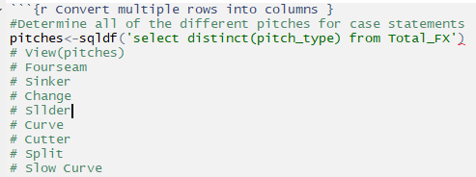
Wrangling PITCHf/x
Data has no TRUE Primary Key
Each row has a unique combo of Pitcher and Pitch Type
Need to convert Pitch Type into columns by combining Pitch Type and the other columns
First need to pull each unique Pitch Type
Notes:
May require more than one slide

Slide 13
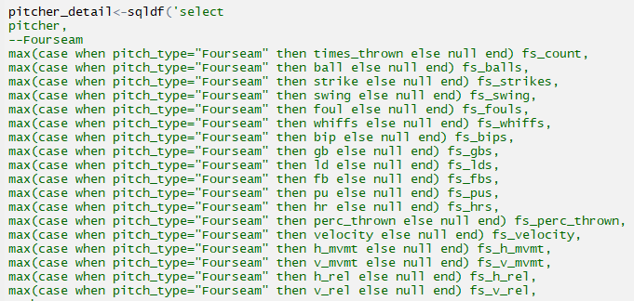
Wrangling PITCHf/x
Create Primary Key
Repeated for each Pitch Type
Notes:
May require more than one slide

Slide 14
Wrangling PITCHf/x
Results
One Table with 72 rows (number of pitchers with more than 4 starts at Coors and have PITCHf/x data)
145 Columns meaning each pitch gets an individual breakout of
times_thrown | perc_thrown
ball | velocity
strike | h_mvmt
swing | v_mvmt
foul | h_rel
whiffs | v_rel
bip | fb
gb | pu
ld | hr
Notes:
May require more than one slide

Slide 15
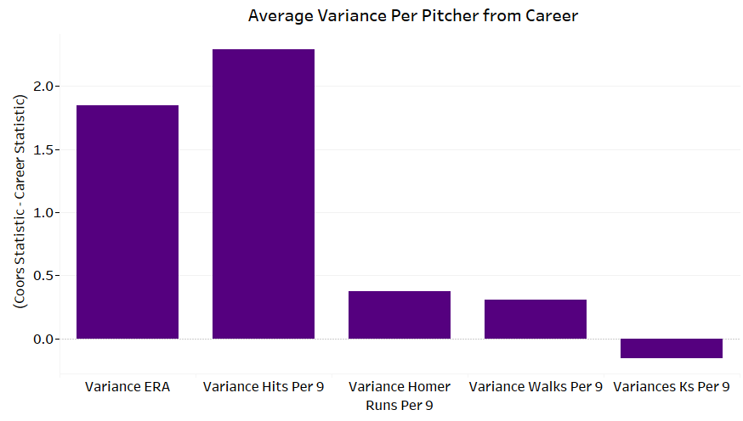
Exploratory Data Analysis
5 major Important statistics in measuring pitcher’s success all show that Coors Field is a detriment to starting pitchers.
Is it a detriment for all starting Pitchers?
Notes:
May require more than one slide

Slide 16
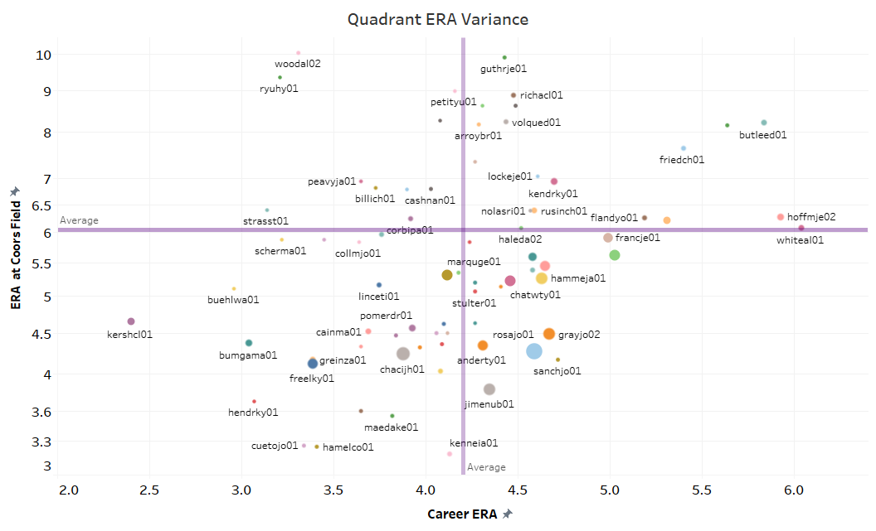
Exploratory Data Analysis
Size of Bubble = Coors Starts
*Red = Above Panel Average
*Black = Below Panel Average
Career/Coors*
Career/Coors*
The top left corner and bottom right corner are particular interesting.
Why do some pitchers find more success at Coors comparatively speaking to how they stack up against the other pitchers’ career wise?
It is clear that Rockies pitchers seem to pitch better at Coors in comparison to their Non-Rockies counter parts.
*Edwin Jackson has an ERA at Coors of 19.18 he deserves to be cut from the graph
Career/Coors*
Career/Coors*
Notes:
May require more than one slide

Slide 17
What can predict success at Coors Field?
Pitch Selection
Prevalence of certain pitches
Pitch Outcomes
Balls in Play, Ground Balls, Home Runs, Whiffs etc..
Career Numbers
Movement of Pitches
Horizontal/Vertical Movement of Pitchers
Release Point of Pitches
Horizontal/Vertical Release Points of Pitches
Velocity of Pitches
Notes:
May require more than one slide

Slide 18
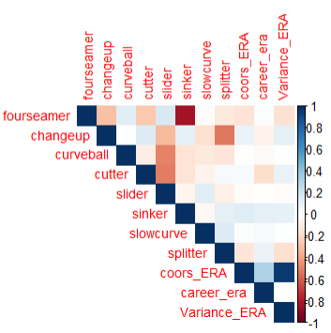
Pitch Selection
Higher %s of four seamers and splitters lead to more success at Coors
Higher %s of Cutters, Sinkers, and Changeups lead to a higher ERA at Coors.
For the most part there is not a huge implication of correlation between pitch selection and success at Coors.
Notes:
May require more than one slide

Slide 19
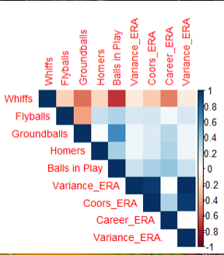
Pitch Outcomes
The correlation between pitch outcomes and success at Coors generally follows that of the pattern for career success. Inquisitively it makes sense miss bats and you will give up less run.
Notes:
May require more than one slide

Slide 20
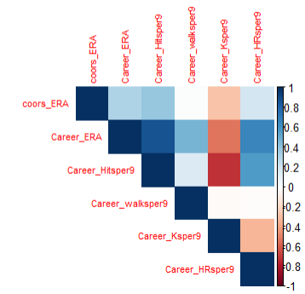
Career Numbers
Looking at the career numbers it seems the same quality of stats that make a pitcher have a successful career translates to success at Coors.
One oddity of note is the lack of correlation between career walks and Coors ERA, I would have thought there would be more correlation here.
Notes:
May require more than one slide

Slide 21
Career Pitch Descriptions
Four-seamers- Pitchers who induce more whiffs from their four seam fastballs correlates with a low
Changeups- Changeups had very little correlation and their impact at Coors
Curveballs- Regardless of movement, release or velocity curveballs had little correlation wit ERA at Coors other than more thrown leading to a slightly higher ERA
Cutters- In general no matter movement or velocity of the cutter, pitchers who feature a cutter have a higher ERA at Coors
Sinkers- Even pitchers with plus velocity and downward movement on their sinkers while translating to career success do not fair as well at Coors
Sliders- Pitchers with plus vertical movement and horizonal movement on their sliders lead to lower Coors ERAs
Slow Curves- this pitch has little no correlation with success at Coors
Splitter – Unanimously splitters seem to be the most successful pitch with pitchers throwing more splitters translating to lower ERAs at Coors
Notes:
May require more than one slide

Slide 22
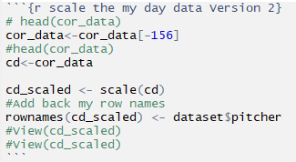
Cluster Analysis (Data Prep)
I ran some different clusters and returned a single pitcher cluster for Josh Collmente so I removed him and reran my analysis
Scaled my data so no factor would skew the distance vectors created in creation of the clusters
Notes:
May require more than one slide

Slide 23
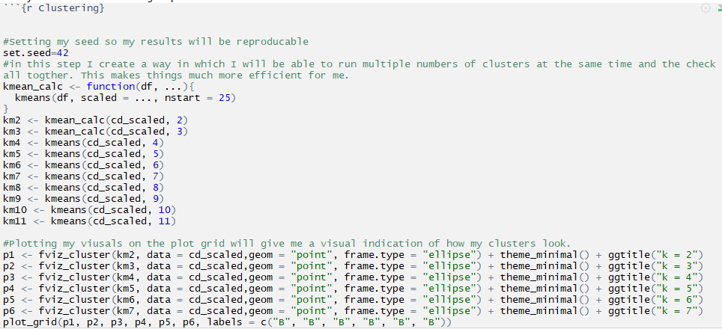
Cluster Analysis (Analysis Prep)
Created a function so that I could run multiple simulations of how the data would look using a different number of color groupings to visualize my data
Notes:
May require more than one slide

Slide 24
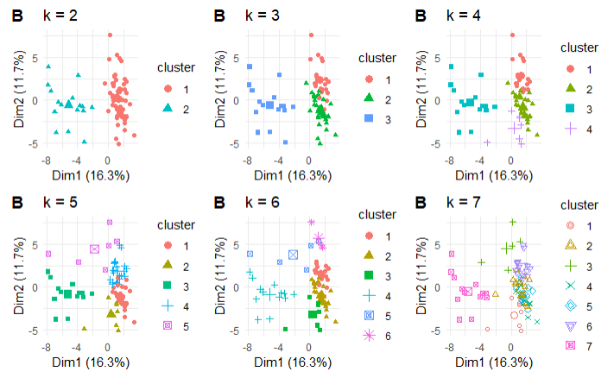
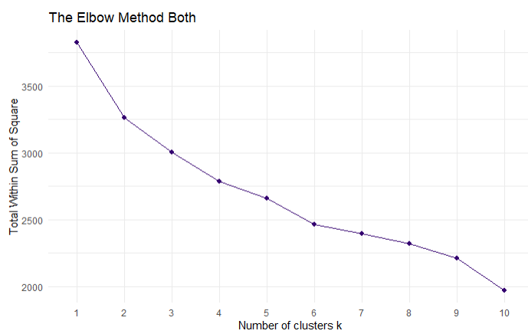
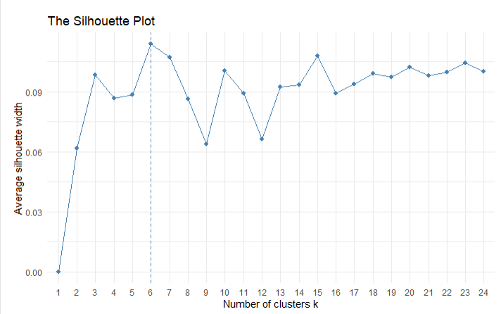
Cluster Analysis (Optimal number of K)
Initially I test how many clusters should be used visually showing the data points, then I perform both the Elbow Method and Silhouette to test for the optimal number of clusters which turns out to be 6.
Notes:
Probably the most well known method, the elbow method, in which the sum of squares at each number of clusters is calculated and graphed, and the user looks for a change of slope from steep to shallow (an elbow) to determine the optimal number of clusters. This method is inexact, but still potentially helpful.
Another visualization that can help determine the optimal number of clusters is called the a silhouette method. Average silhouette method computes the average silhouette of observations for different values of k. The optimal number of clusters k is the one that maximize the average silhouette over a range of possible values for k

Slide 25
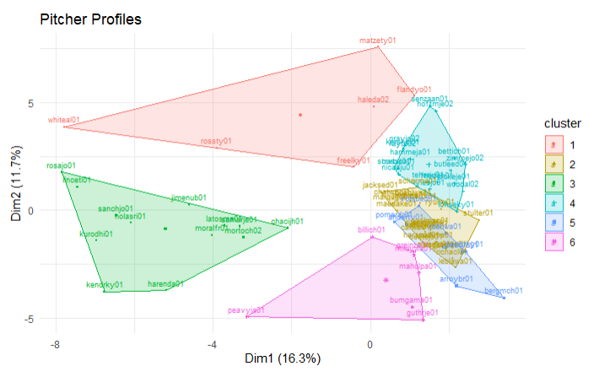
Cluster Analysis Graphic Results
Clear distinction between 1,3, and 6 with 4 having little overlap
2 and 5 have a lot of overlap with little distinction between the two
Notes:
May require more than one slide

Slide 26
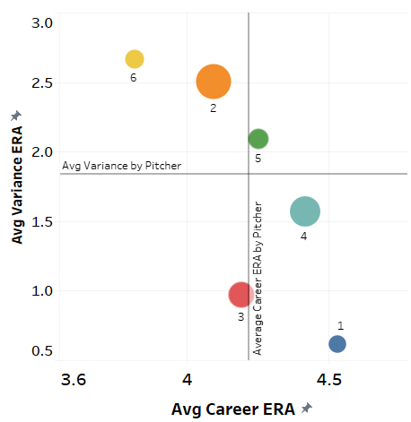
Cluster Analysis Graphic Results
From the chart you can see that profiles 1,3, and 4 find more success at Coors Field even with 1 and 4 having below average career ERAs
What allows profiles 1 and 4 to pitch better at Coors while career wise they are below profiles 2,5, and 6
Notes:
May require more than one slide

Slide 27
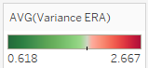
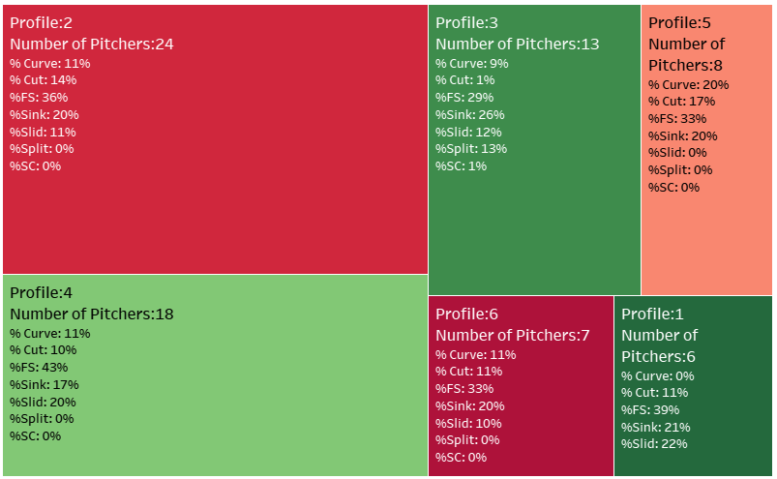
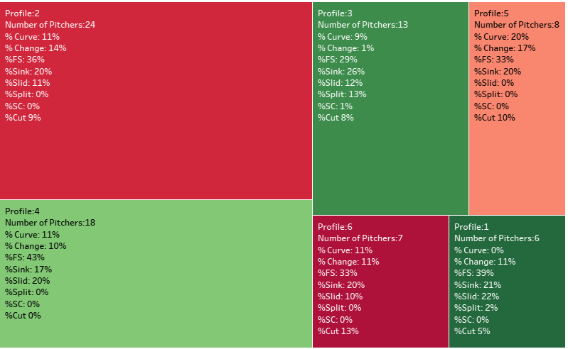
Cluster Analysis Graphic Results
Based on Pitch descriptions the highest performing clusters feature almost exclusively four seamer, sinker, slider, and splitter
What allows profiles 1 and 4 to pitch better at Coors while career wise they are below profiles 2,5, and 6
Notes:
May require more than one slide

Slide 28
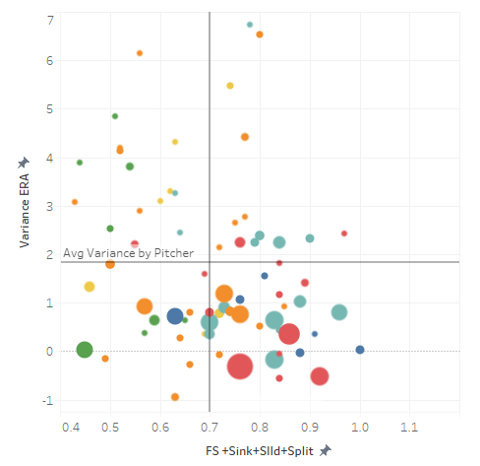
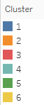
Cluster Analysis Graphic Results
In looking at the data a combine percentage thrown above 70% for four seamers, sliders, sinkers, and splitters appears to lead to a lower variance
We can also see that these buckets largely have more games pitched at Coors.
47 number of pitchers with a variance below the mean 1.843
32 number of those pitchers with at least 70% thrown pitches four seamers, sliders, sinkers, and splitters
In looking at the bubble sizes you can see that pitchers featuring four seamers, sliders, sinkers, and splitters have more career games at Coors
Notes:
May require more than one slide

Slide 29
Linear Regression
In looking at my clustering it seems that the combination of four seamers, sliders, sinkers, and splitters when thrown more prevalently than other pitches has a positive impact on reducing a pitcher’s variance
Notes:
May require more than one slide

Slide 30
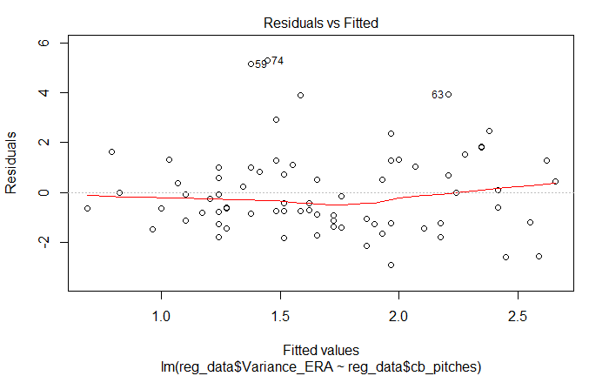
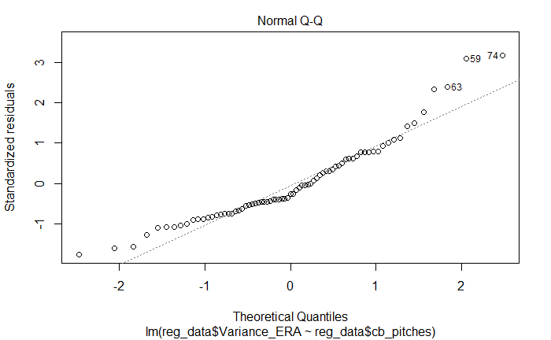
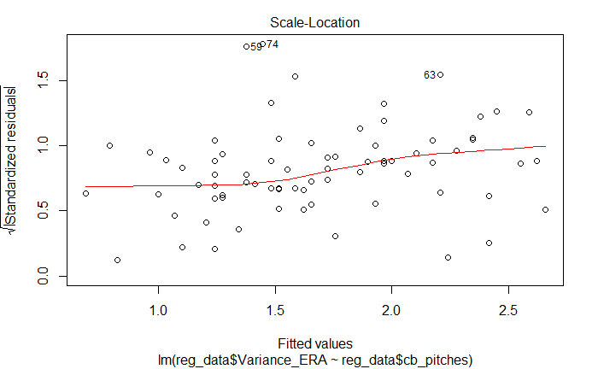
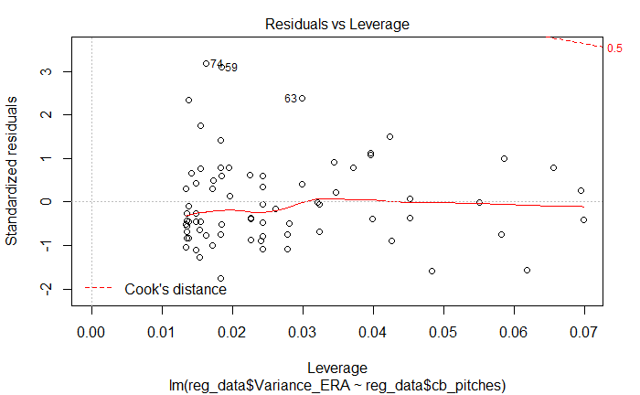
Linear Regression- Testing Assumptions
1
2
Linearity (1)
Line is horizontal without a defined patterned, met.
Normality (2)
Points for the most part fall on the line only a few exceptions at the extremes of the x axis
Homogeneity (3)
Points scattered not in groups assumption met
Outliers
I have two pints which exceed 3 standard deviations
I may look to exclude these from my analysis
3
4
Notes:
May require more than one slide

Slide 31
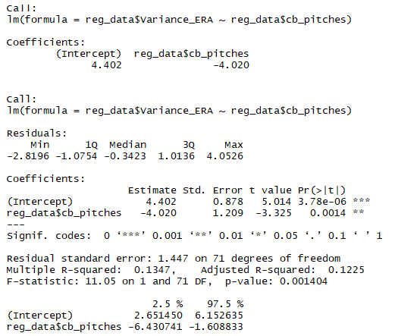
Linear Regression
The average value of combined (FS+Sink+Split+SllD) produces a variance ERA of 4.402
For every 1 unit increase in that combined pitch percentage a variance ERA of -4.020 is produced
My t values indicated how many standard deviations I am away from the standard error, both are relatively large in comparison to my standard errors which is good for my analysis.
Small P values for slope and intercept allow us to reject null hypothesis and conclude there is a relationship between variance and combined pitch percentage
Residual Standard error tells me the avg amount my variance will deviate from the regression line by around 1.447
The multiple R-Squared value of .1347 which tells us that roughly 13.5% of the variance can be explained by combined pitch percentage….not great
This is a good start at least as it does indicate that there is a relationship it just might not be best found using linear regression
Notes:
May require more than one slide

Slide 32
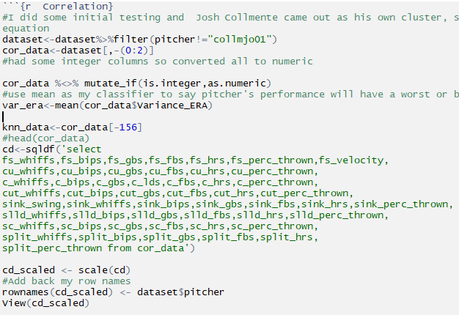
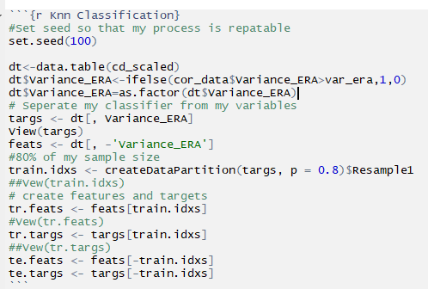
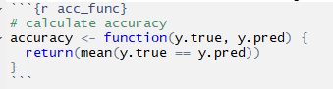
Knn Classification
Prep Data
Divide Data into training and testing
Create function to test accuracy
Notes:
May require more than one slide

Slide 33
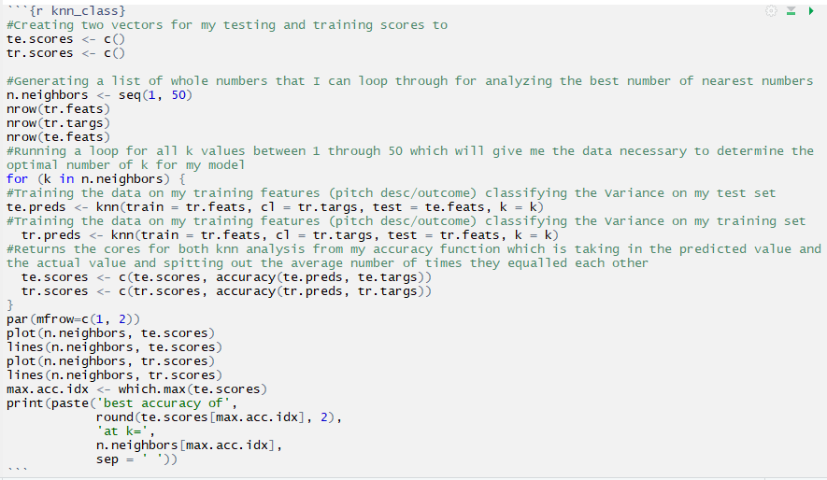
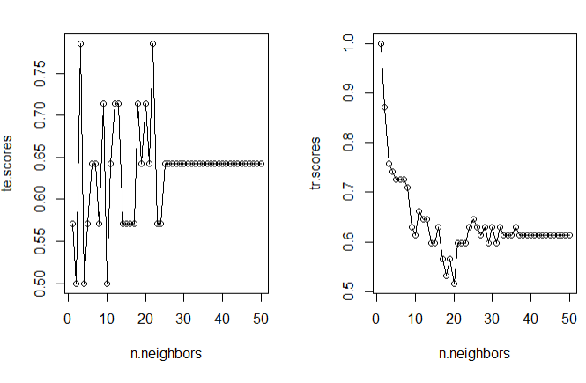
Knn Classification
Run Classification for multiple values of R
[1] "Testing Scores best accuracy of 0.79 at k= 3" [1] "Training Scores best accuracy of 0.76 at k= 3"
Notes:
May require more than one slide

Slide 34
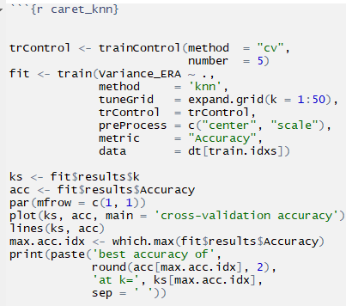
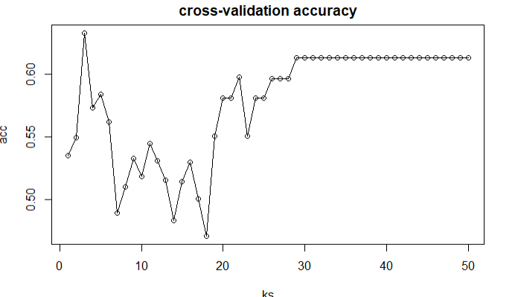
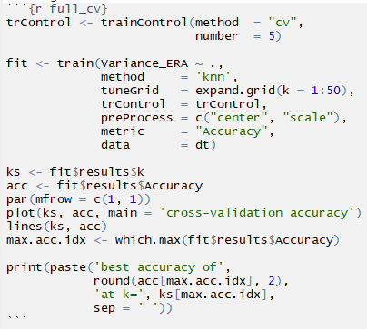
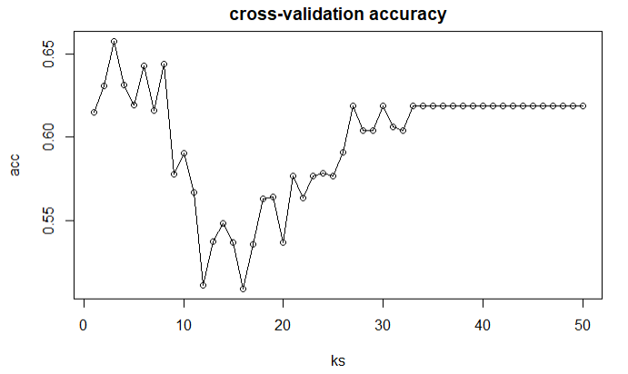
Knn Classification Cross Validation
Cross Validation Training Data
Accuracy of 63% at k=3
Cross Validation Full Data Set
Accuracy of 66% at k=3
Notes:
May require more than one slide

Slide 35
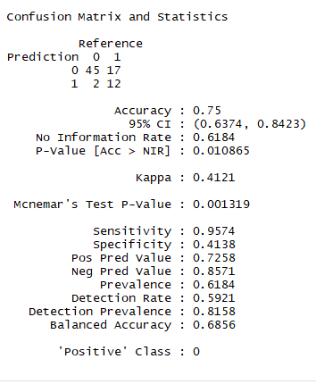
Test Accuracy of data on entire set (Pitchers >4 Starts)
Test Accuracy
It seems as though my model has a tendency to predict a better variance than average. My model mistakenly predicts 2 pitchers having over the average variance, while it mistakenly predicts 17 being under the variance. But overall the model’s performance at 75% which is a good start in building further analysis to be more precise.
Notes:
May require more than one slide

Slide 36
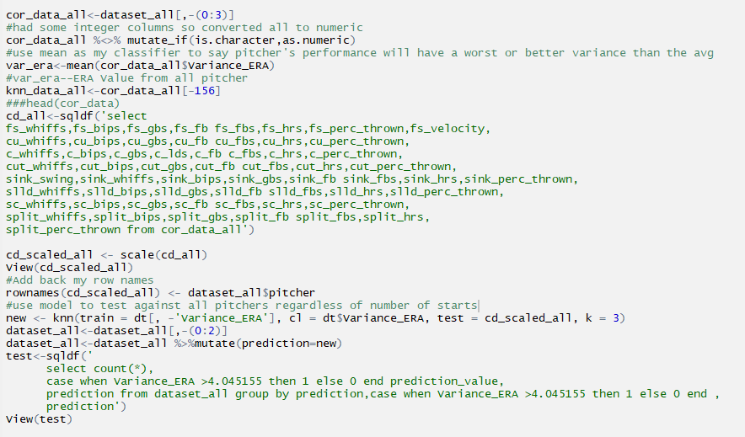
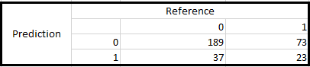
Apply Model to All Pitchers not limited to 5 or more Starts
Run Model for all pitchers with a start a Coors
Results
Overall Results were alright using a dataset consisting of only pitchers with more than four starts my model correctly predicted whether a pitcher would have a variance above or below the average 66% of the time.
I think using pitchers with more experience at Coors likely skewed my data toward lower variance as evident by my results.
Notes:
May require more than one slide

Slide 37
Conclusions
In fully analyzing the data it is clear that the more games a pitcher starts at Coors Field the better their Coors ERA in comparison to their Career ERA
Moving forward I may want to create flags for pitchers based on games pitched as it will give me more flexibility in my analysis
Another finding of my data which supported my initial thoughts on pitching profiles for success at Coors was the high prevalence of Rockies pitchers that predominantly throw four seamers, sinkers, sliders and splitters.
Career ground ball rates did not seem to have much correlation with Coors ERA, this surprised me
Notes:
May require more than one slide

Slide 38
Wrap Up
Lessons Learned
Moving Forward
Do not make decisions to limit the data early
I limited data based on having a minimum of 5 starts, should have done all my analysis than made those decisions
Find a better way to measure horizontal movement
Needed to somehow scale horizontal movement for righties and lefties so that the numbers were all positive regardless of which way it moved
Incrementally check engineered data
My data was very messy and it took a lot of manipulation to make it read for analysis
Inducing incremental QA along the way before spending too much time implementing my manipulations
Set up less manually processes around collection and manipulation
On a time constraint this was difficult but will be able to set those up next time
Use all pitchers regardless of number of starts
Create tag to flag Rockies Pitchers so that they can be easily added or removed from analysis
Utilize Knn Regression to predict more exact ERA for pitchers at Coors as opposed to just determining if they will fair better or worst than the average pitcher
Begin to build on the work I have done utilizing the weather data I have created to begin creating coefficients for weather, starting pitchers, batters, and bullpen
Notes:
May require more than one slide

Slide 39
Appendix
Notes:
May require more than one slide

Slide 40
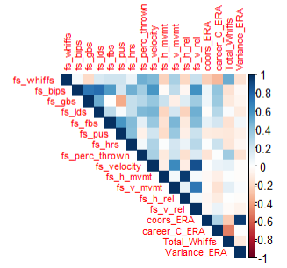
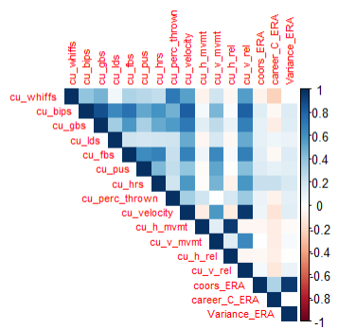
Four Seamers
Change Ups
Notes:
May require more than one slide

Slide 41


Curveballs
Cutters
Notes:
May require more than one slide

Slide 42


Sinkers
Sliders
Notes:
May require more than one slide

Slide 43

Splitters
Notes:
May require more than one slide

